Slide 1
INFORMED (HEURISTIC) SEARCH STRATEGIES
Course Code: CSC4226
Course Title: Artificial Intelligence and Expert System
Dept. of Computer Science
Faculty of Science and Technology
Lecture No: | Four (4) | Week No: | Four (4) | Semester:
Lecturer: | Dr. Muhammad Firoz Mridha, Associate Professor, Dept of CS Email: firoz.mridha@aiub.edu

Slide 2
LECTURE OUTLINE
BEST-FIRST SEARCH
GREEDY BEST-FIRST SEARCH
A* SEARCH
CONDITIONS FOR OPTIMALITY
OPTIMALITY OF A*

Slide 3
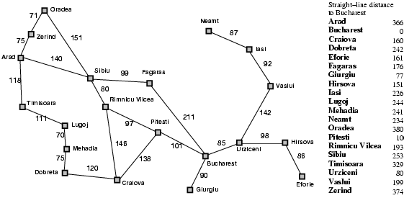
Romania with step costs in km

Slide 4
INFORMED SEARCH STRATEGY
Informed search strategy—
one that uses problem-specific knowledge beyond the definition of the problem itself
can find solutions more efficiently than can an uninformed strategy.
problem-specific knowledge
is the extra bit of information the program uses rather than
the problem formulation, thus known as Informed Search

Slide 5
BEST-FIRST SEARCH
The general approach to informed search is called best-first search
Best-first search is an instance of the general TREE-SEARCH or GRAPH-SEARCH algorithm in which a node is selected for expansion based on an evaluation function, f(n).
The evaluation function is construed as a cost estimate, so the node with the lowest evaluation is expanded first
The implementation of best-first graph search is identical to that for uniform-cost search, except for the use of f instead of g to order the priority queue.
The choice of f determines the search strategy.

Slide 6
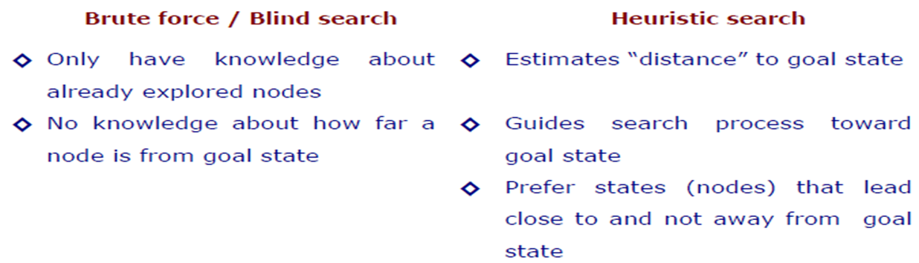
HEURISTIC SEARCH COMPARED WITH BLIND SEARCH

Slide 7
HEURISTIC FUNCTION
The choice of f(evaluation function) determines the search strategy
Best-first algorithms include as a component of f a heuristic function, denoted h(n)
h(n) = estimated cost of the cheapest path from the state at node n to a goal state.
h(n) takes a node as input, but, unlike g(n), it depends only on the state at that node.
Heuristic functions are the most common form in which additional knowledge of the problem is imparted to the search algorithm
Consider them to be arbitrary, nonnegative, problem-specific functions, with one constraint: if n is a goal node, then h(n)=0.

Slide 8
GREEDY BEST-FIRST SEARCH
Greedy best-first search8 tries to expand the node that is closest to the goal, on the grounds that this is likely to lead to a solution quickly.
Thus, it evaluates nodes by using just the heuristic function; that is, f(n) = h(n).
“greedy”—at each step it tries to get as close to the goal as it can.
Its search cost is minimal. It is not optimal.
Greedy best-first tree search is also incomplete even in a finite state space, much like depth-first search.

Slide 9
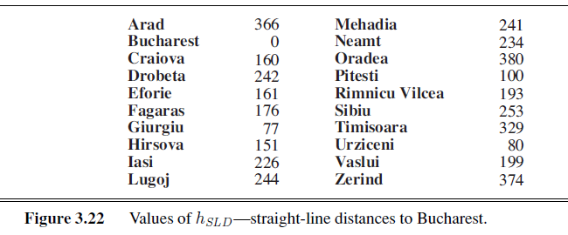
STRAIGHT-LINE DISTANCE HEURISTIC

Slide 10
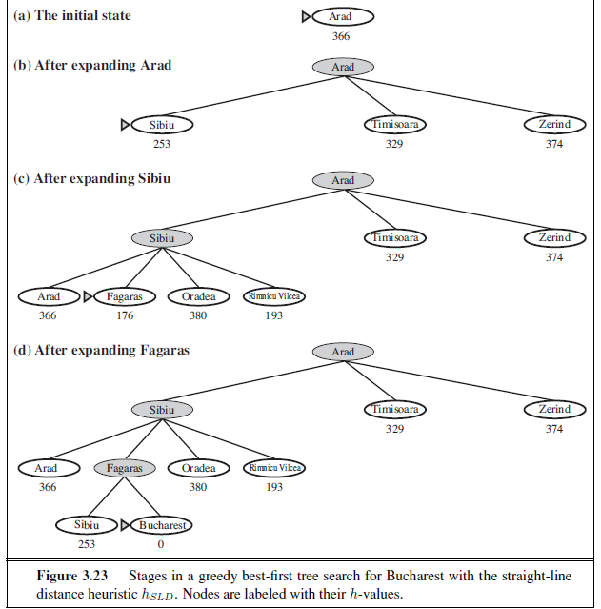
GREEDY BEST-FIRST TREE SEARCH

Slide 11
A* SEARCH: MINIMIZING THE TOTAL ESTIMATED SOLUTION COST
The most widely known form of best-first search is called A*search
It evaluates nodes by combining
g(n), the cost to reach the node, and
h(n), the cost to get from the node to the goal:
f(n) = g(n) + h(n) .
Since
g(n) gives the path cost from the start node to node n, and
h(n) is the estimated cost of the cheapest path from n to the goal,
we have f(n) = estimated cost of the cheapest solution through n .
A∗ search is both complete and optimal.
The algorithm is identical to UNIFORM-COST-SEARCH except that
A∗ uses g + h instead of g.

Slide 12
We have now arrived at Bucharest. As this is the lowest cost node AND the goal state we can terminate the search. If you look back over the slides you will see that the solution returned by the A* search pattern ( Arad – Sibiu – Rimnicu – Pitesti – Bucharest ), is in fact the optimal solution. Press space to continue with the slideshow.
In actual fact, the algorithm will not really recognise that we have found Bucharest. It just keeps expanding the lowest cost nodes (based on f ) until it finds a goal state AND it has the lowest value of f. So, we must now move to Fagaras and expand it. Press space to continue.
Press space to see an A* search of the Romanian map featured in the previous slide. Note: Throughout the animation all nodes are labelled with f(n) = g(n) + h(n). However,we will be using the abbreviations f, g and h to make the notation simpler
We now expand Sibiu (that is, we expand the node with the lowest value of f ). Press space to continue the search.
We now expand Rimnicu (that is, we expand the node with the lowest value of f ). Press space to continue the search.
We now expand Pitesti (that is, we expand the node with the lowest value of f ). Press space to continue the search.
Once Arad is expanded we look for the node with the lowest cost. Sibiu has the lowest value for f. (The cost to reach Sibiu from Arad is 140 miles, and the straight line distance from Sibiu to the goal state is 253 miles. This gives a total of 393 miles). Press space to move to this node and expand it.
Once Rimnicu is expanded we look for the node with the lowest cost. As you can see, Pitesti has the lowest value for f. (The cost to reach Pitesti from Arad is 317 miles, and the straight line distance from Pitesti to the goal state is 98 miles. This gives a total of 415 miles). Press space to move to this node and expand it.
We have just expanded a node (Pitesti) that revealed Bucharest, but it has a cost of 418. If there is any other lower cost node (and in this case there is one cheaper node, Fagaras, with a cost of 417) then we need to expand it in case it leads to a better solution to Bucharest than the 418 solution we have already found. Press space to continue.
We begin with the initial state of Arad. The cost of reaching Arad from Arad (or g value) is 0 miles. The straight line distance from Arad to Bucharest (or h value) is 366 miles. This gives us a total value of ( f = g + h ) 366 miles. Press space to expand the initial state of Arad.
We now expand Fagaras (that is, we expand the node with the lowest value of f ). Press space to continue the search.
Zerind
F= 75 + 374
F= 449
Oradea
F= 291 + 380
F= 671
Arad
F= 0 + 366
F= 366
Fagaras
Sibiu
F= 239 + 178
F= 417
F= 140 + 253
F= 393
Bucharest(2)
F= 118 + 329
F= 447
F= 220 + 193
F= 413
Rimnicu
F= 450 + 0
F= 450
Timisoara
Bucharest
Bucharest
Bucharest
Bucharest
Pitesti
F= 418 + 0
F= 418
Craiova
F= 317 + 98
F= 415
F= 366 + 160
F= 526
Once Fagaras is expanded we look for the lowest cost node. As you can see, we now have two Bucharest nodes. One of these nodes ( Arad – Sibiu – Rimnicu – Pitesti – Bucharest ) has an f value of 418. The other node (Arad – Sibiu – Fagaras – Bucharest(2) ) has an f value of 450. We therefore move to the first Bucharest node and expand it. Press space to continue

Slide 13
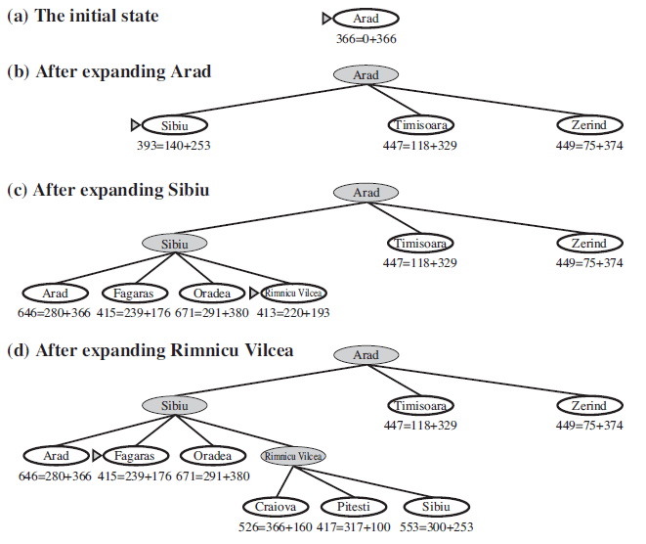
A∗ SEARCH FOR BUCHAREST

Slide 14
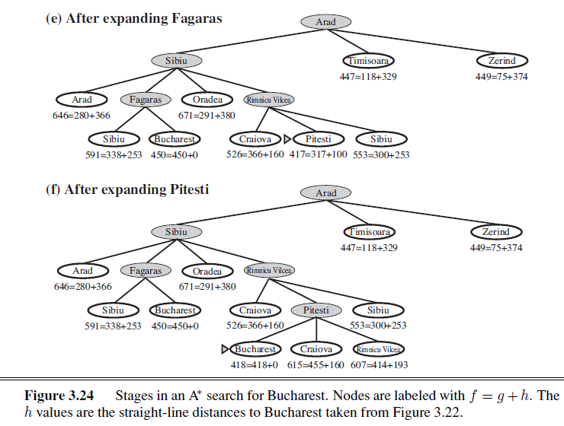
A∗ SEARCH FOR BUCHAREST

Slide 15
CONDITIONS FOR OPTIMALITY: ADMISSIBILITY AND CONSISTENCY
The first condition we require for optimality is that h(n) be an admissible heuristic
An admissible heuristic is one that never overestimates the cost to reach the goal
Because g(n) is the actual cost to reach n along the current path, and f(n)=g(n) + h(n), we have as an immediate consequence that f(n) never overestimates the true cost of a solution along the current path through n.
Admissible heuristics are by nature optimistic because they think the cost of solving the problem is less than it actually is.

Slide 16
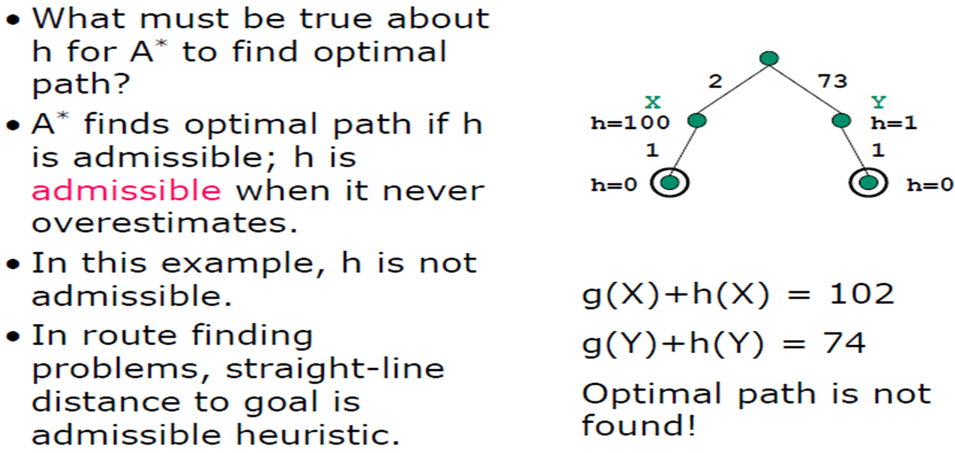
ADMISSIBILITY

Slide 17
CONSISTENCY
A second, slightly stronger condition called consistency (or sometimes monotonicity) is required only for applications of A∗ to graph search.
A heuristic h(n) is consistent if, for every node n and every successor n of n generated by any action a, the estimated cost of reaching the goal from n is no greater than the step cost of getting to n plus the estimated cost of reaching the goal from n :
h(n) ≤ c(n, a, n’) + h(n’).
This is a form of the general triangle inequality, which stipulates that each side of a triangle cannot be longer than the sum of the other two sides

Slide 18
OPTIMALITY OF A*
A∗ has the following properties: the tree-search version of A∗ is optimal if h(n) is admissible, while the graph-search version is optimal if h(n) is consistent.
if h(n) is consistent, then the values of f(n) along any path are nondecreasing.
The proof follows directly from the definition of consistency. Suppose n is a successor of n; then g(n’)=g(n) + c(n, a, n’) for some action a, and we have
f(n) = g(n) + h(n) = g(n) + c(n, a, n) + h(n) ≥ g(n) + h(n) = f(n) .
The next step is to prove that whenever A∗ selects a node n for expansion, the optimal path to that node has been found. Were this not the case, there would have to be another frontier node n on the optimal path from the start node to n. because f is nondecreasing along any path, n would have lower f-cost than n and would have been selected first.

Slide 19
Local search algorithms
The search algorithms that we have seen so far are designed to explore search space systematically
Systematicity is achieved by keeping one or more paths in memory and by recording which alternatives have been explored at each point along the path and which have not
When a goal is found, the path to that goal also constitute a solution to the problem
In many optimization problems, the path to the goal is irrelevant; the goal state itself is the solution
In such cases, we can use local search algorithms
keep a single "current" state, try to improve it

Slide 20

Example: n-queens
Put n queens on an n × n board with no two queens on the same row, column, or diagonal

Slide 21
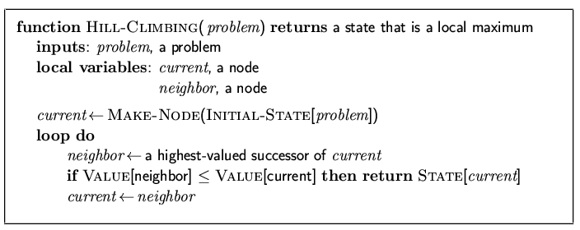
Hill-climbing search
"Like climbing Everest in thick fog with amnesia"

Slide 22
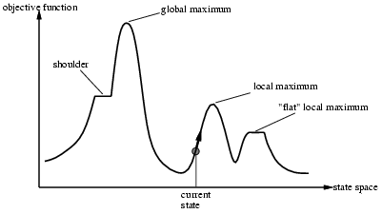
Hill-climbing search
Problem: depending on initial state, can get stuck in local maxima

Slide 23
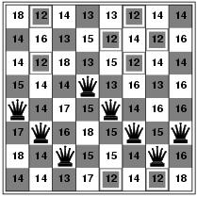
Hill-climbing search: 8-queens problem
h = number of pairs of queens that are attacking each other, either directly or indirectly
h = 17 for the above state

Slide 24
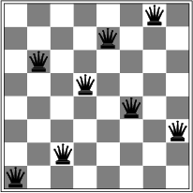
Hill-climbing search: 8-queens problem
A local minimum with h = 1

Slide 25
AI - HEURISTIC SEARCH
Heuristic search refers to a search strategy that attempts to optimize a problem by iteratively improving the solution based on a given heuristic function or a cost measure.
A Heuristic is a technique to solve a problem faster than classic methods, or to find an approximate solution when classic methods cannot.
This is a kind of a shortcut as we often trade one of optimality, completeness, accuracy, or precision for speed.

Slide 26
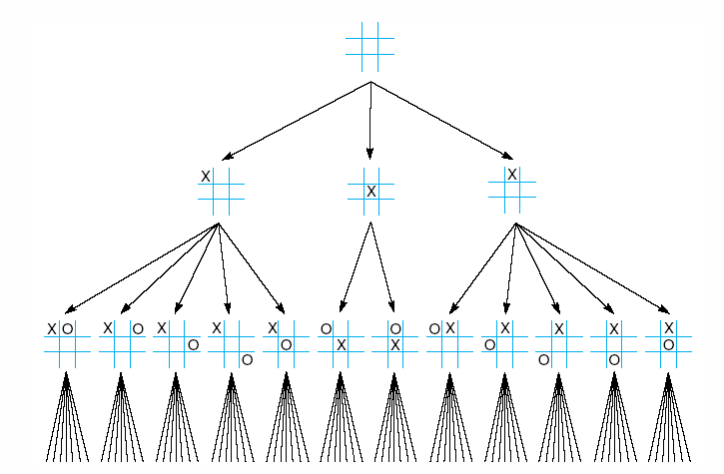
Fig 4.1 First three levels of the tic-tac-toe state space reduced by symmetry

Slide 27
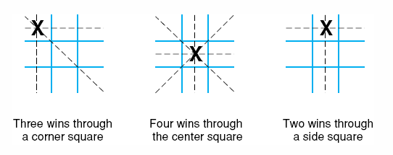
Fig 4.2 The “most wins” heuristic applied to the first children in tic-tac-toe.

Slide 28
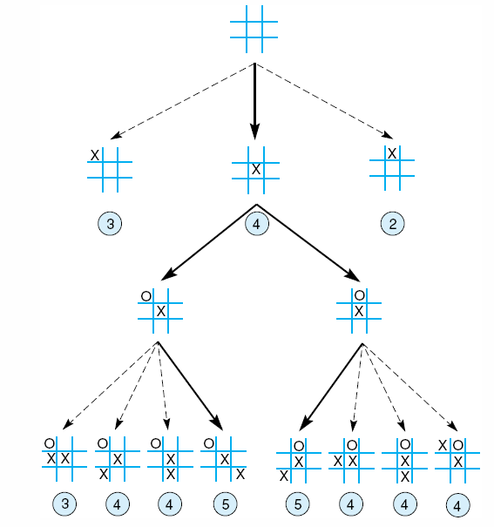
Fig 4.3 Heuristically reduced state space for tic-tac-toe.
4

Slide 29
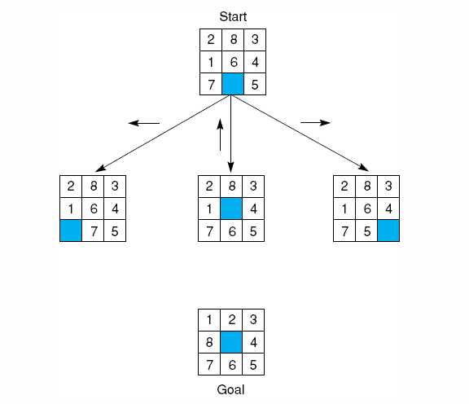
Fig 4.12 The start state, first moves, and goal state for an example-8 puzzle.
Notes:
Insert fig 4.12

Slide 30
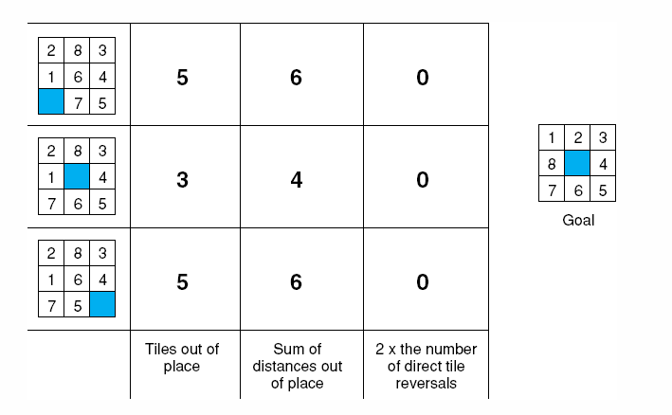
Fig 4.14 Three heuristics applied to states in the 8-puzzle.

Slide 31
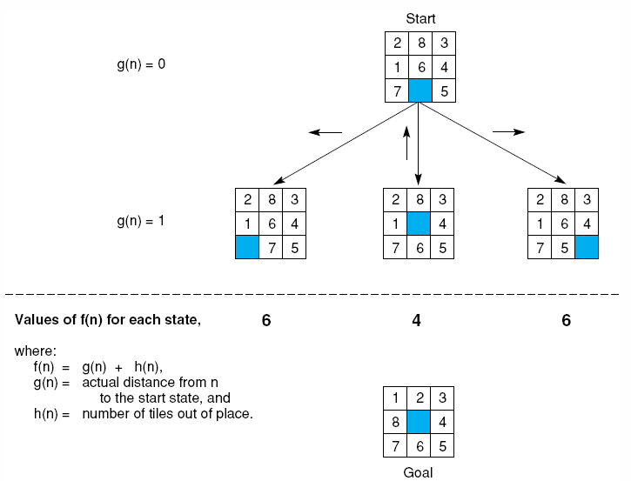
Fig 4.15 The heuristic f applied to states in the 8-puzzle.
Notes:
Insert fig 4.15

Slide 32
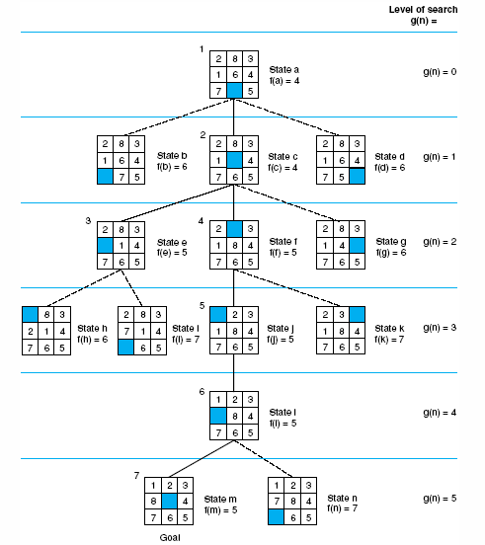
Fig 4.16 State space generated in heuristic search of the 8-puzzle graph.
Notes:
Insert fig 4.16

Slide 33
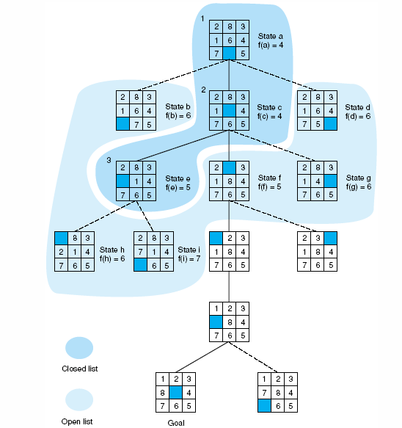
Fig 4.17 Open and closed as they appear after the 3rd iteration of heuristic search

Slide 34
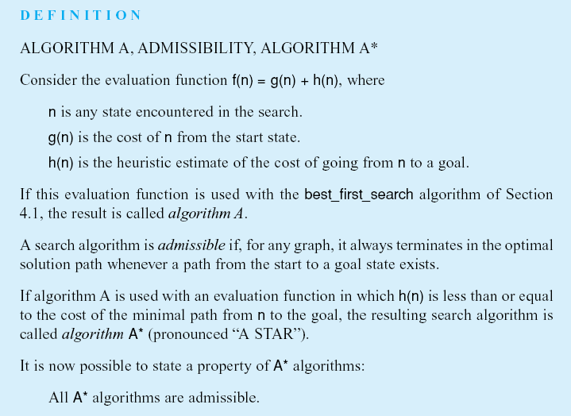
Notes:
Insert def box page 146

Slide 35
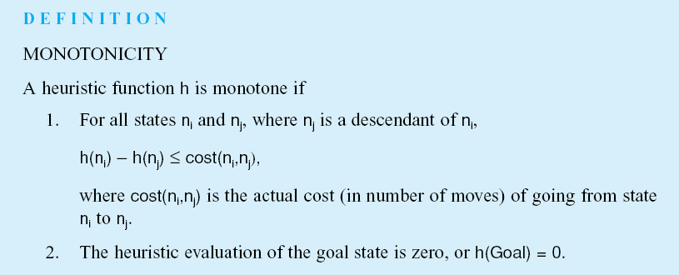
Notes:
Insert def box, pg 147

Slide 36
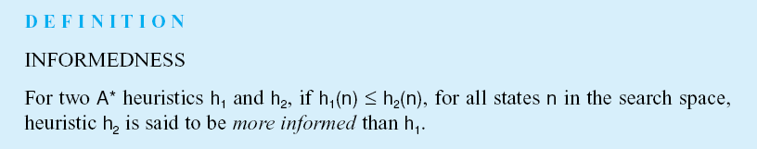
Notes:
Insert def box, pg 148

Slide 37
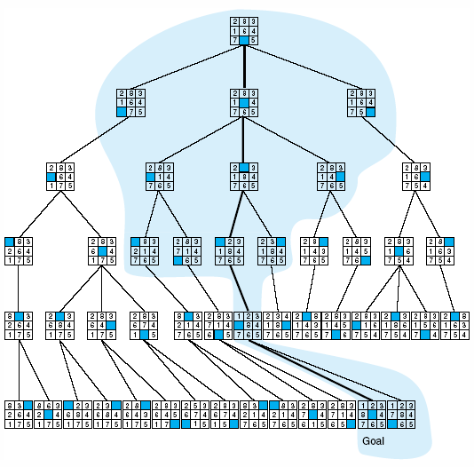
Fig 4.18 Comparison of state space searched using heuristic search with space searched by breadth-first search. The proportion of the graph searched heuristically is shaded. The optimal search selection is in bold. Heuristic used is f(n) = g(n) + h(n) where h(n) is tiles out of place.

Slide 38
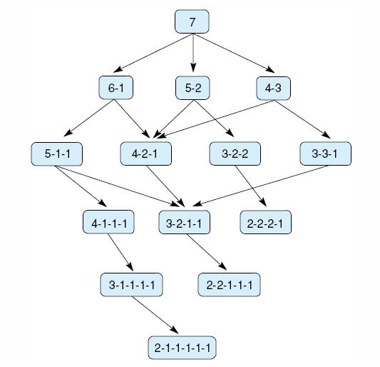
Fig 4.19 State space for a variant of nim. Each state partitions the seven matches into one or more piles.

Slide 39
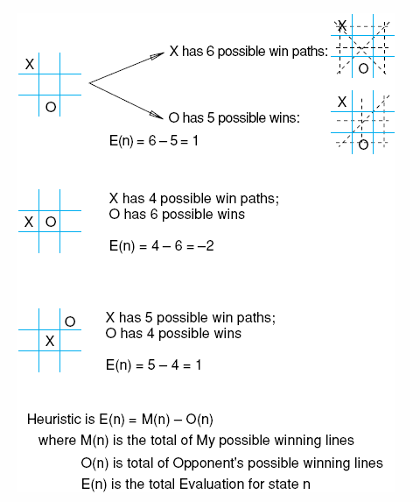
Fig 4.22 Heuristic measuring conflict applied to states of tic-tac-toe.

Slide 40
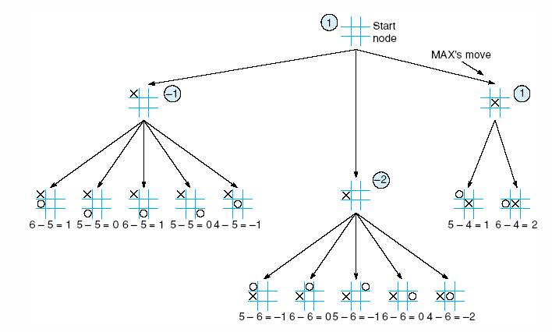
Fig 4.23 Two-ply minimax applied to the opening move of tic-tac-toe, from Nilsson (1971).

Slide 41
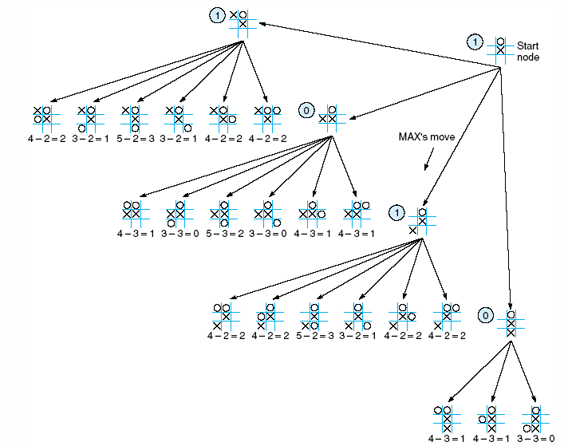
Fig 4.24 Two ply minimax, and one of two possible MAX second moves, from Nilsson (1971).

Slide 42
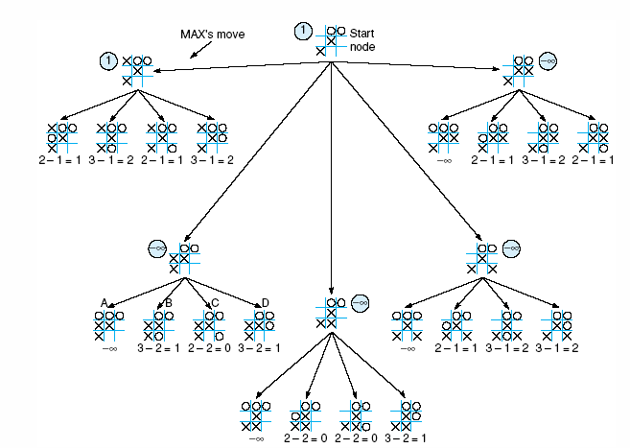
Fig 4.25 Two-ply minimax applied to X’s move near the end of the game, from Nilsson (1971).

Slide 43
QUIZ-One
Introduction
Intelligent Agent

Slide 44
References
Chapter 3: Solving Problem by Searching , Pages 92-97
“Artificial Intelligence: A Modern Approach,” by Stuart J. Russell and Peter Norvig,

Slide 45
Books
“Artificial Intelligence: A Modern Approach,” by Stuart J. Russell and Peter Norvig.
"Artificial Intelligence: Structures and Strategies for Complex Problem Solving", by George F. Luger, (2002)
"Artificial Intelligence: Theory and Practice", by Thomas Dean.
"AI: A New Synthesis", by Nils J. Nilsson.
“Programming for machine learning,” by J. Ross Quinlan,
“Neural Computing Theory and Practice,” by Philip D. Wasserman, .
“Neural Network Design,” by Martin T. Hagan, Howard B. Demuth, Mark H. Beale, .
“Practical Genetic Algorithms,” by Randy L. Haupt and Sue Ellen Haupt.
“Genetic Algorithms in Search, optimization and Machine learning,” by David E. Goldberg.
"Computational Intelligence: A Logical Approach", by David Poole, Alan Mackworth, and Randy Goebel.
“Introduction to Turbo Prolog”, by Carl Townsend.

